Slide 1

File Cryptography
Team
Mahmoud Hassan-1710681
Adham Ali Shahen-19200051
Omar Mohamed Abdelrazek-19106149
Abdullah Fathy-19200112

Slide 2

What is File Cryptography
Cryptography is the technique of encrypting information to secure data transmission.
It’s a necessity when using the internet.
It could be used to secure Local Files using password aka. Key.

Slide 3
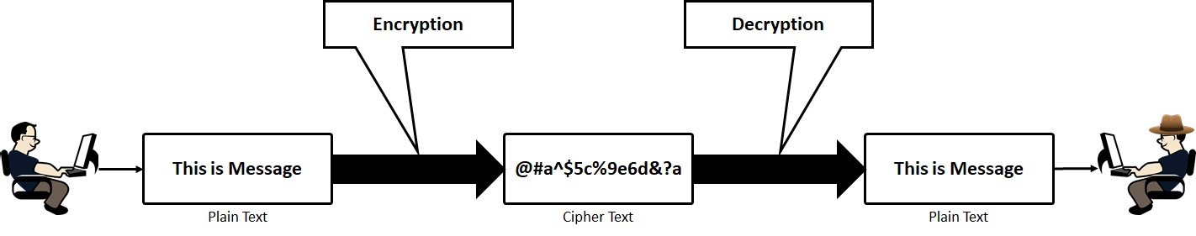
How Cryptography Works
In the cryptographic technique, we encrypt the desired file and send the encrypted file through the channel.
Without knowing how to decrypt the file, no once can open the file and see the content in the middle of a transmission.
Then, when the file reaches the right person, who in this case is your fellow gangster, will decrypt and open the file because only he knows how to decrypt the file.

Slide 4
Types of Cryptography
Now everything is set, the only thing remaining is to know which type of cryptography to choose. Sender and receiver should know the difference of these types based on how he encrypts and decrypts the file. His choice should be one of the below:
Symmetric Key Cryptography
Asymmetric Key Cryptography

Slide 5
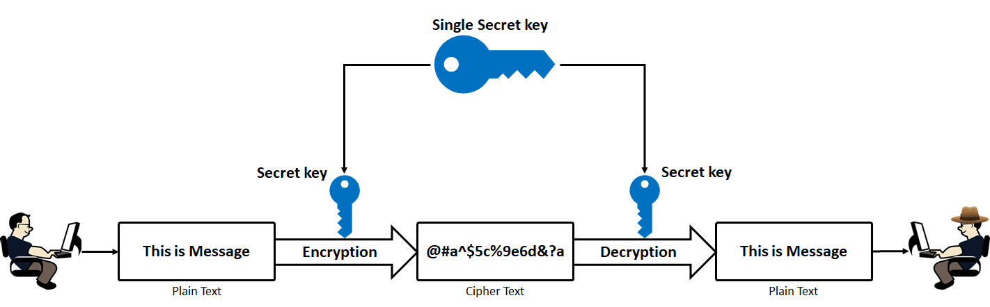
Symmetric Key Cryptography
Symmetric key cryptography is also called Private key Cryptography. In this approach, both the sender and receiver will use the same key for encrypting and decrypting the message. Sender will encrypt the data with a secret key. Then the receiver will use the same key to decrypt the received data.

Slide 6
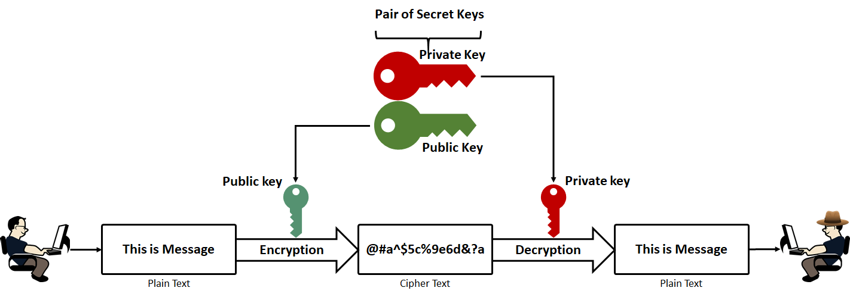
Asymmetric Key Cryptography
Asymmetric Key Cryptography is called as Public-key cryptography. In this approach, Receiver will use Private Key to Decrypt and Sender will use Public Key Encrypt. Asymmetric Key Cryptography is called as Public-key cryptography. In this approach, Receiver will use Private Key to Decrypt and Sender will use Public Key Encrypt.

Slide 7
Project
Our project is aims to develop file cryptography and Analysis.
A random List of folders were generated from 20 to 100 per Dir.
Each Dir has another number of files. It’s a bit Simple since a set of variables determines the depth, number and size of content in each file.
133284 files were generated in preparation to Encryption.

Slide 8
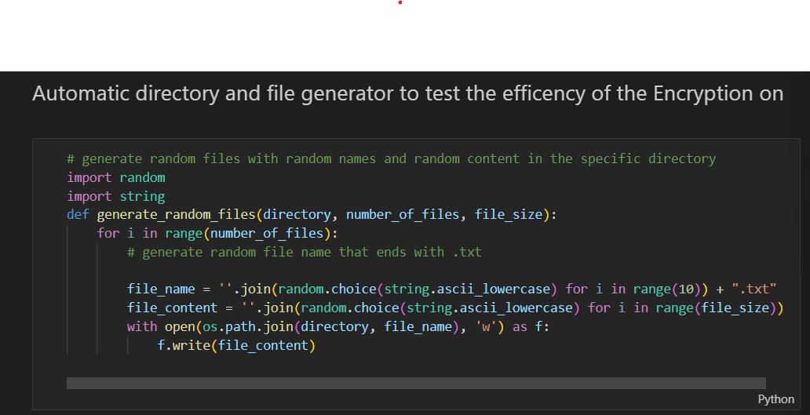
Code

Slide 9

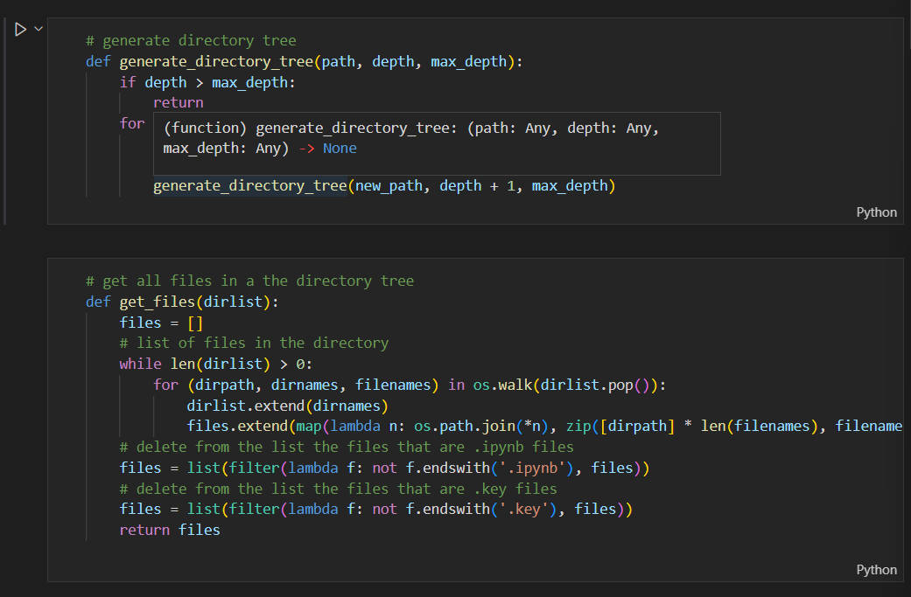
Code

Slide 10

Dir & File Tree

Slide 11

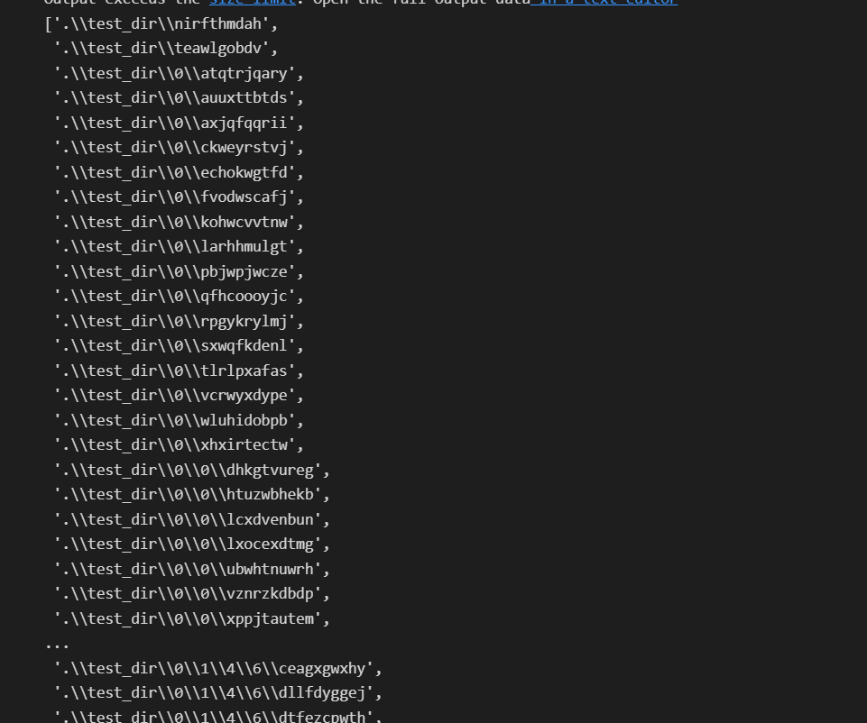
List of all Files

Slide 12

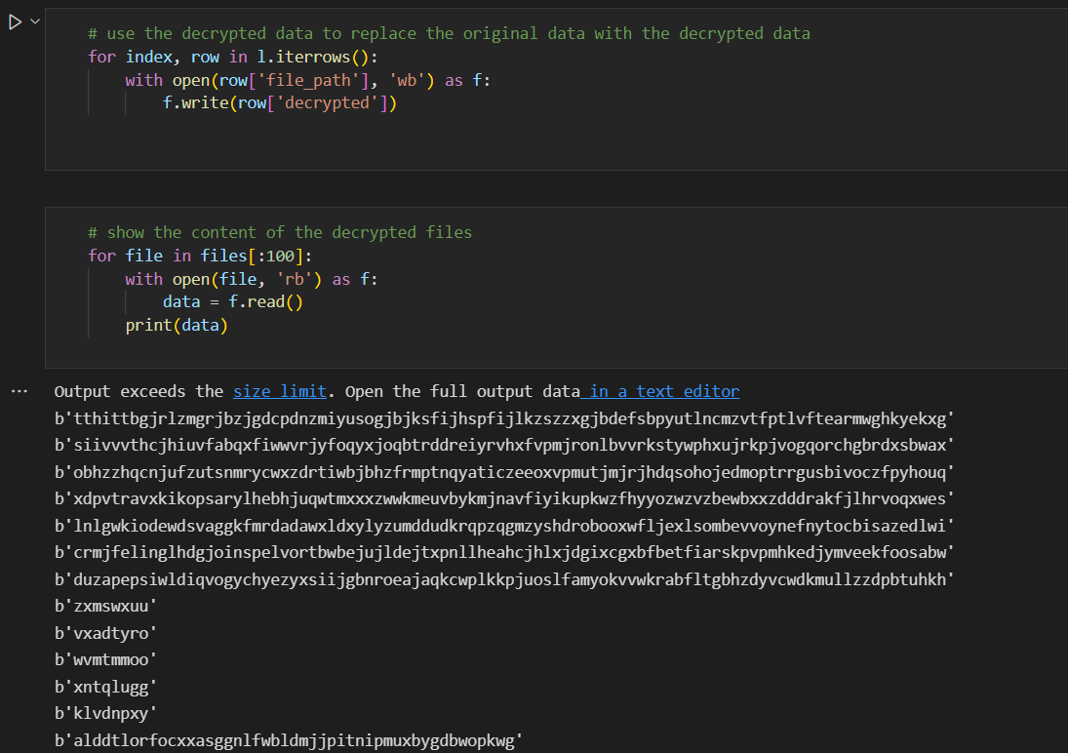
decrypted content which was decrypted by a random key

Slide 13

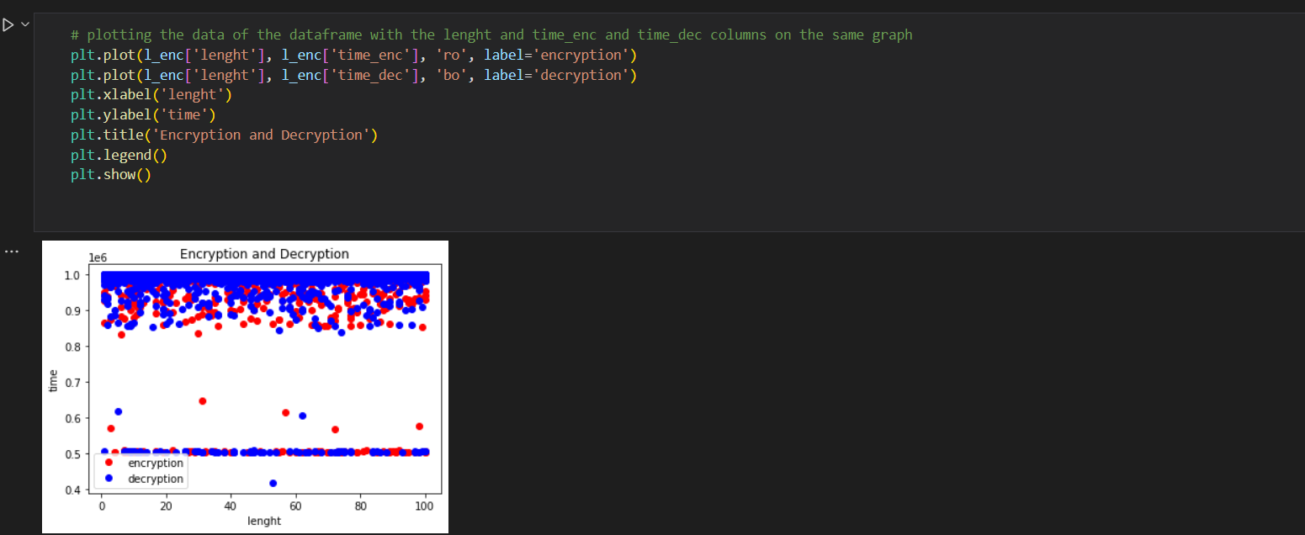
Time Analysis

Slide 14

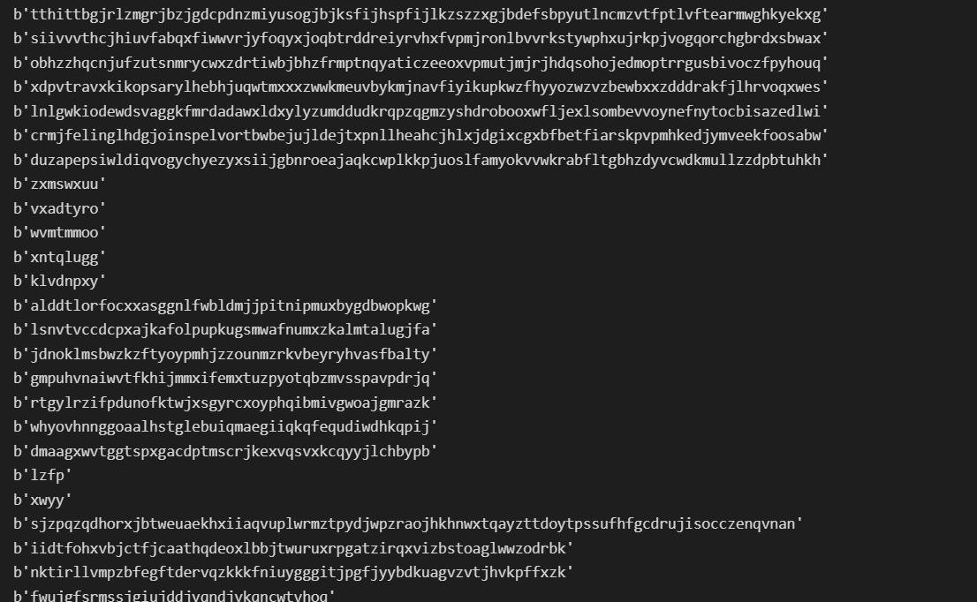
Random Encryption Samples

Slide 15
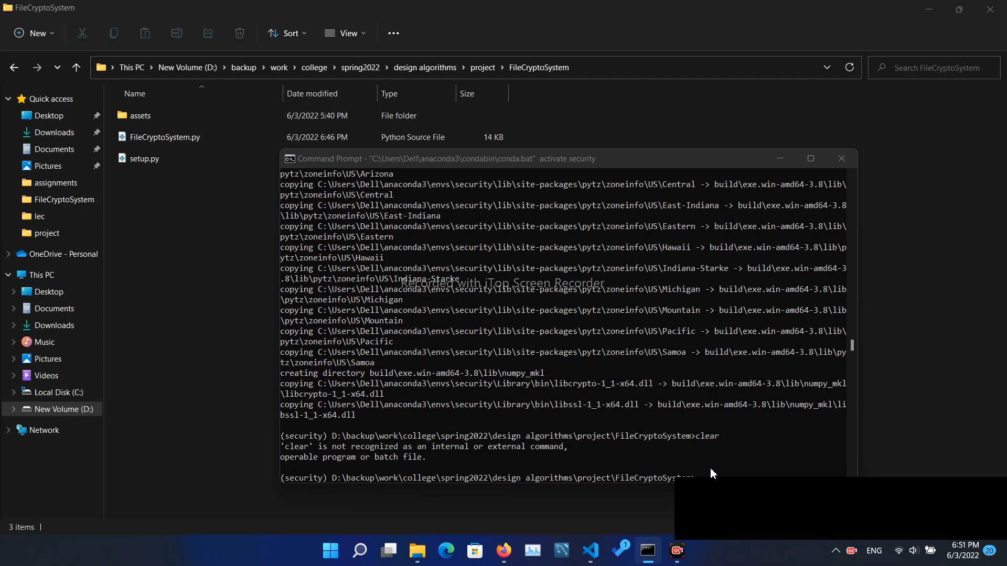
User Interface

Slide 16
References
Kaspersky. (2022, February 9). Cryptography definition. www.kaspersky.com. Retrieved June 3, 2022, from https://www.kaspersky.com/resource-center/definitions/what-is-cryptography
Rajagopal, P. V. K., & Prabhu Vignesh Kumar RajagopalExperienced DevSecOps Practitioner. (2020, May 5). What is cryptography and its types? Digital Varys. Retrieved June 3, 2022, from https://digitalvarys.com/what-is-cryptography-and-its-types
Microsoft. (n.d.). Bing. Retrieved June 3, 2022, from https://www.bing.com/search?q=what%2Bis%2Bfile%2Bcryptography&FORM=HDRSC1

Slide 17

Thank You

